Slide 1


Slide 2

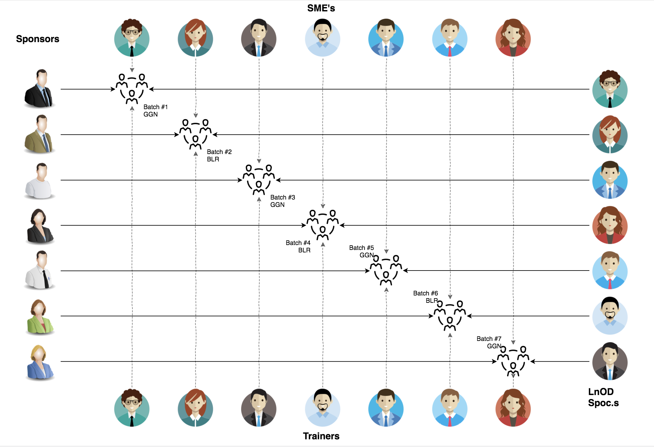
Stakeholders
Sponsors
Flipkart
SME’s
Deepika Gajraj
Khushboo (Order Trainings)
Pooja Sudarshan
3. Trainers
Amit Balyan

Slide 3
PROJECT FRAMEWORK
Timeline | Modules | Description
Day 1,2,3 (19th May – 21st May) | UNIX GIT UML Diagrams | Understanding Unix and Git commands Requirement understanding and diagram design
Day 4,5,6 (24th May – 26th May) | Java 8 Exception Handling SQL | Developing a POS Application using Java and MySQL. Understanding Java 8 features and collections
Day 7,8 (27th May – 28th May) | Jersey and DropWizard | REST API Development using Jersey and DropWizard framework

Slide 4
Our next starts
NOW
Notes:
Time – 1 min
Swati

Slide 5
Training Program
8 Days
192 Hours
11,520 Minutes
6,91,200 Seconds
Limitless Knowledge

Slide 6

Our Team
Notes:
Time – 2 mins

Slide 7


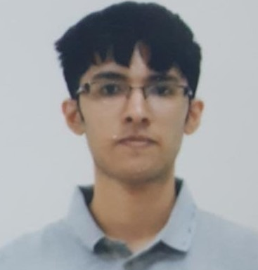
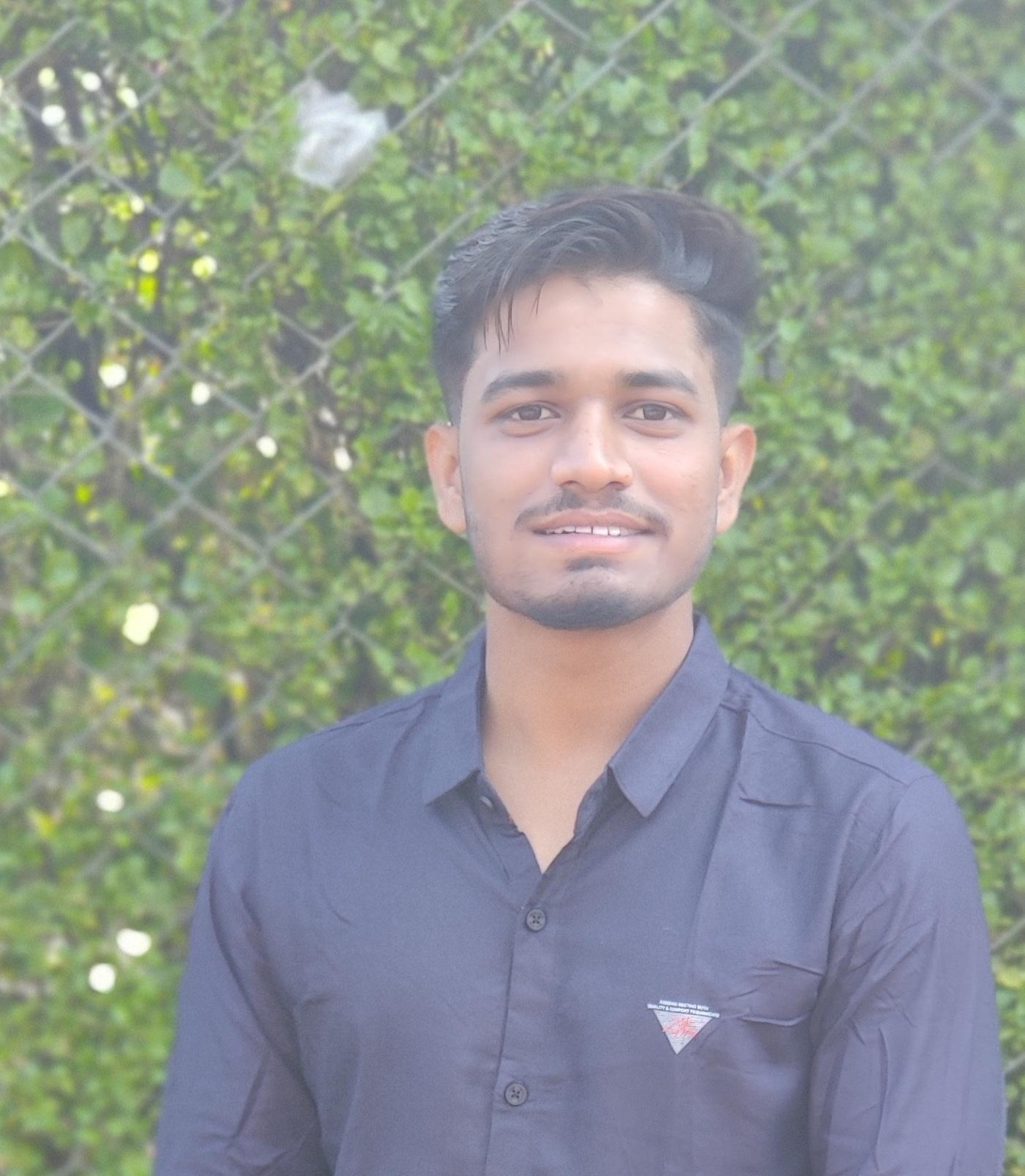
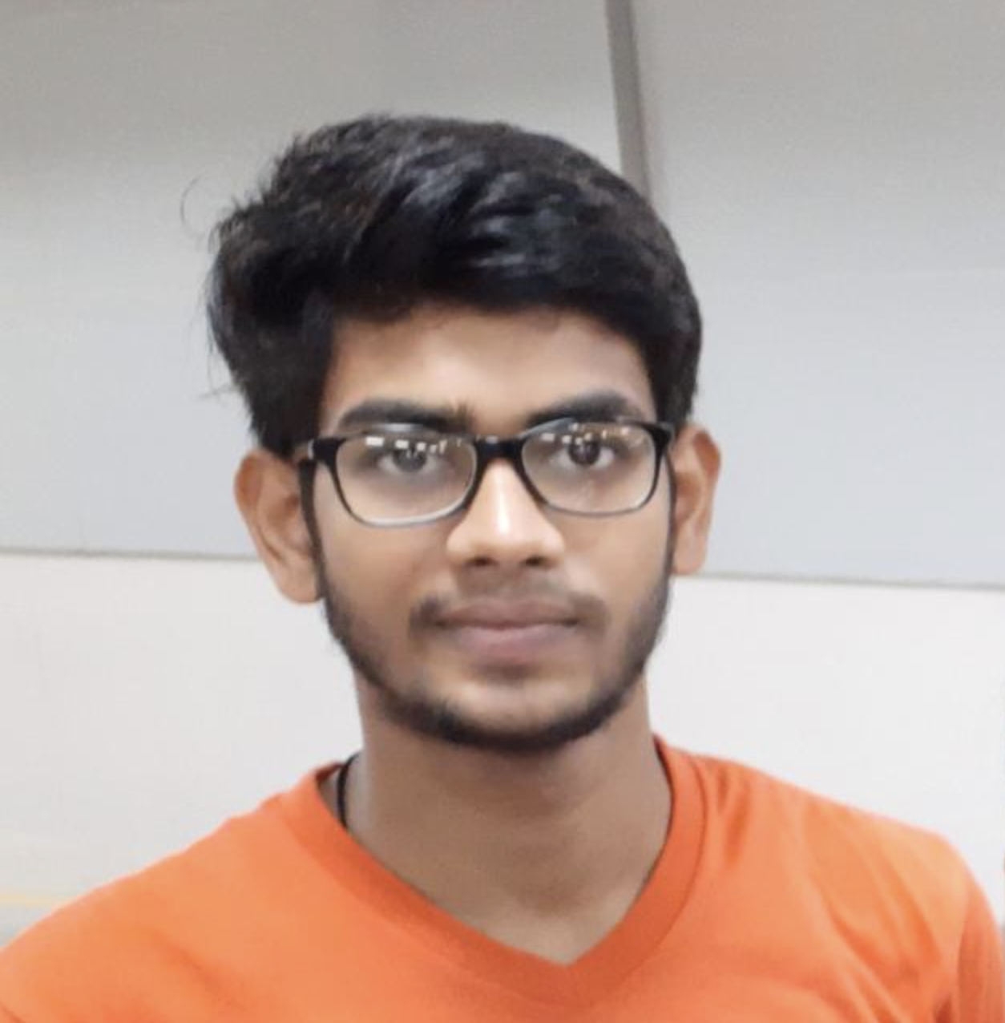

Team Overview
Vikram (TL)
Vennela
Nitin
Pooja
Rishabh
Satyam

Slide 8

Agenda
01
Project Goals
02
Brief overview of the Problem Statement
03
Development Cycle
04
Engineering Practices
05
Tech Stack
06
Learnings & Challenges
07
Demo
08
Questions
Notes:
Time – 1 min

Slide 9

Project Goals
Notes:
Time – 3 mins

Slide 10




Problem Statement
To develop a POS application and REST API for Course Registration System using JAVA where the Student can register, add/drop course, Professors can view courses, grade enrolled students while Admin can manage users, add/drop courses to catalog, assign courses to Professors.
1
2
Quality
Security
3
4
Interactivity
Speed
Notes:
User satisfaction and brand value
Problem Statement

Slide 11
Brief Overview of the Problem Statement

Slide 12
Course Management System (CRS)
Student
Admin
Professor
Register Courses
Add/Drop Course
Register themselves
View Registered Courses
Pay Fee
View Course Catalog
View Report Card
Add Professor
Assign Course to Professor
Approve Student Registration
Add/Delete Courses
View Pending Admissions
Update Catalog
Generate Report Card
Grade Students
View Courses to Teach
View Registered Students
View Professor Details
View Professor Courses

Slide 13





MySQL
DB
HTTP Request
HTTP Response
UI
Business Code
Database Code
(Client Package)
(Service Package)
(Dao Package)

Slide 14
Software Development Cycle
Testing & Integration
Validations, Unit tests, Maintenance
Requirement Collection
Understanding the Problem statement
05
01
04
CRS
Coding
Console, REST, Dropwizard
Analysis
Choosing tech stack
Class design
02
03
Designing
UML Artifacts Architecture design

Slide 15

Engineering Practices
Notes:
Time – 5 mins

Slide 16
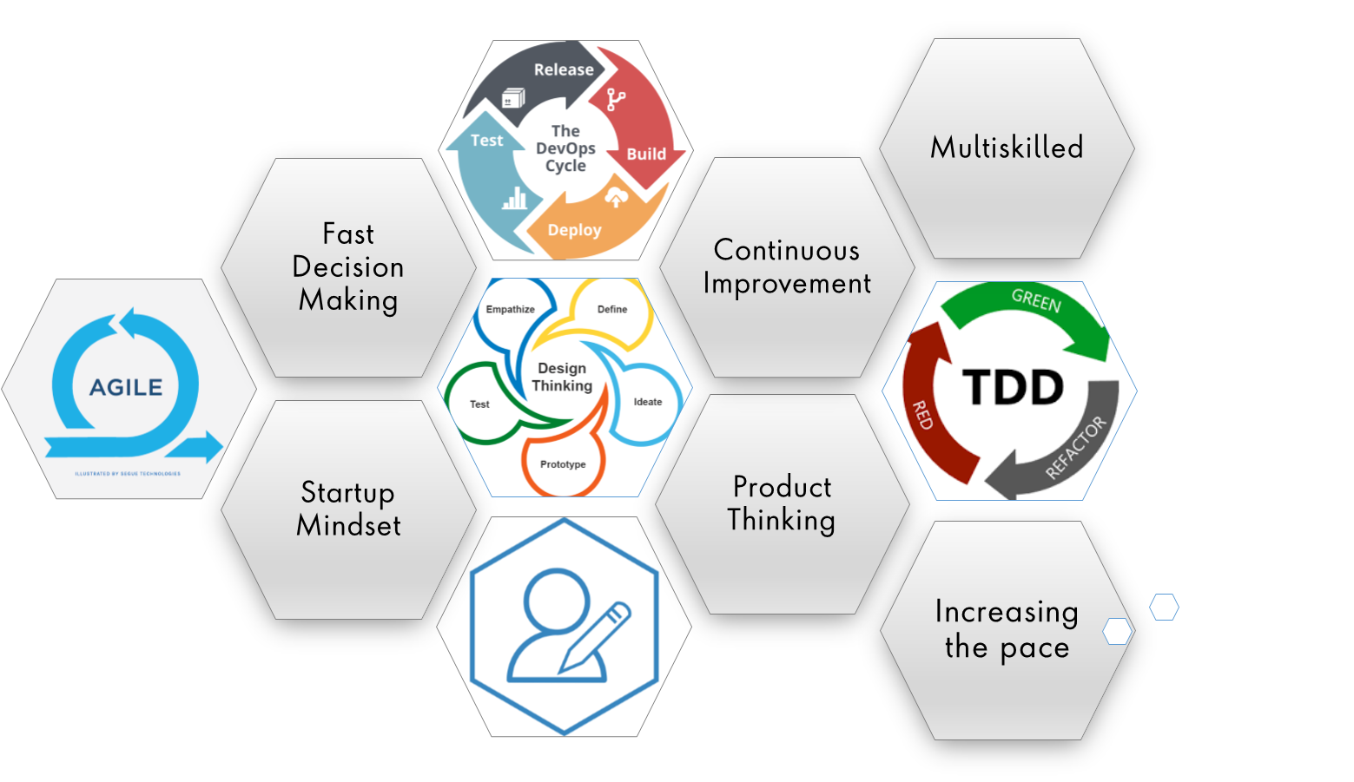
Notes:
Product Thinking (Design Thinking, Requirement Analysis, )
Multi Skilled (Frontend, Backend, DevOps)
Fast Decision Making (Agile)
Increasing the Pace (Automation CI/CD)
Startup Mindset (Agile)
Continuous Improvement (Retros)

Slide 17
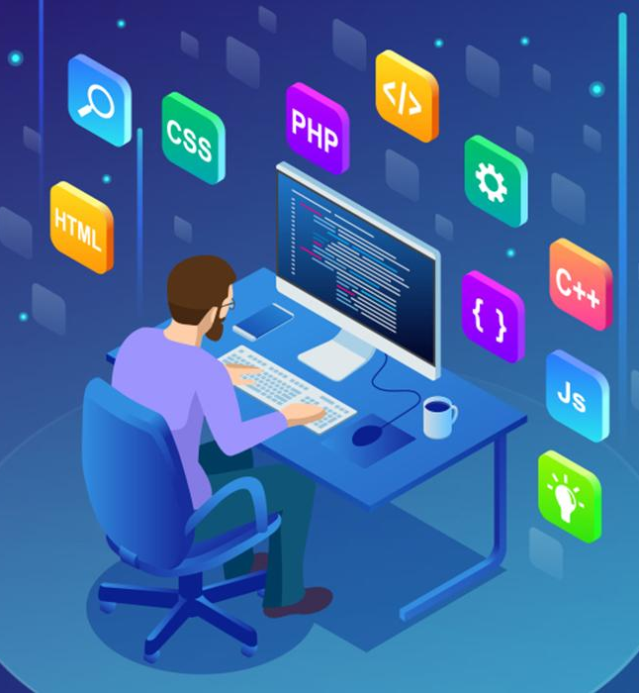
Tech Stack
Notes:
Time – 2 mins

Slide 18






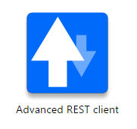







Designing
Backend
Testing
Data
SCM
UML
Core Language
Tools
SQL Database
Code Collaboration
Framework
Application Server
Notes:
Time – 1 min
Java
Maven
DropWizard
MySQL
Jersey
GitHub
Postman / ARC (Check it)
StarUML / Dia / Lucid Charts
List
Design
Backend
Testing
Tools

Slide 19

Challenges & Learnings
Notes:
Time – 2 mins

Slide 20
Challenges | Learnings
Understanding the problem statement Collaboration issues such as merge conflicts in Git UML diagram conventions | UNIX Ubuntu Git commands UML Diagrams GitHub
Installation software on multiple environments POS application development using layered architecture | Java 8 Exception Handling SQL
Resolving jar and version dependencies Jersey validation Running Apache TomCat server | REST API development using Jersey and DropWizard DropWizard Postman , Apache TomCat

Slide 21

CRS Demo
Notes:
Time –
Architecture – 5 mins
NFR Dashboard – 3 mins
Demo – 10 mins
1. Show the Responsiveness and Wave tool first

Slide 22

Notes:
Time - ?

Slide 23
Thank you
Notes:
Time – After this show the testimonial video. 1 min

